Slide 1
Microsoft Dictionary
Last update: December 2023

Slide 2
Key Terms & Acronyms Defined
MSFT: Microsoft Field Team; also used to refer to Microsoft as a whole
MS: another way you might see Microsoft abbreviated
ACR: Azure Consumed Revenue; how much money they’ll be spending in Azure; cost of Azure cloud)
PAU: Paid Active Users; the amount of licensing the organization has paid for
MAU: Monthly Active Users; the amount of licensing actually being used by an organization each month
Win Wire: a case study shared to Microsoft highlighting a client win, focused on ACR & licensing growth
EBC: Executive Briefing Center; located in Redmond to offer executive-level engagement with Microsoft engineering, sales, industry, and business function leadership; inspire customers through examples of Microsoft’s technology and thought-leadership, immersive demos, and presentations of real-life customer scenarios
MTC: Microsoft Technology Center; empower digital transformation and business outcomes through immersive experiences and deep technical engagements; led by Technical Architects who have established credibility in IT and solution sales skills
Partner Center: central hub for managing the Microsoft partnership; most commonly used by AMs for sharing pipeline with Microsoft and receiving leads
Territory Channel Manager (TCM): responsible for all sales in a specific solution area and segment (examples: Data & AI for SMC-West; Azure for SMB)
Partner Development Manager (PDM): main point of contact between Long View & Microsoft
Partner Marketing Advisor (PMA): helps with partner marketing & brand awareness activities

Slide 3
Microsoft Product Suite
Cloud
Business Apps
Modern Work
Security
Hardware
Azure
DevOps
Virtual Desktop
Databases
Containers & Kubernetes
Artificial Intelligence & Machine Learning
Internet of Things
Power platform
BI
Apps
Automate
Copilot
Dynamics
Sales & marketing
Service
Finance
Commerce
Supply chain
Sales Copilot
GitHub Copilot
M365 & Office
E3, E5 licenses
O365 = cloud
Teams
SharePoint
OneDrive
Viva
Edge
Copilot
M365 Copilot
Copilot w/ Commercial Data Protection
Defender
Active Directory
Azure Key Vault
Sentinel
Multi-Factor Authentication
Intune
Surface
HoloLens
PC accessories
Note: This is not an exhaustive list, but a starting point.
For more information on each product, start with the Baseline & Partner training on the Sales Training & Enablement Program

Slide 4
How to Purchase Microsoft
EA: Enterprise Agreement
“Traditional” licensing model
Direct with Microsoft or through partner
Best for organizations with 500+ users
Typically 3-year agreements with annual “true-up”
Purchase covers entire organization
Payments are annually or for all 3 years at once
CSP: Cloud Service Provider
Newer licensing model
Through partners
Best for smaller, more dynamic organizations
Agreements are month-to-month or 1-year
Purchases can be made as needed; no minimum users
Payments are monthly or annually
Long View differentiators: dedicated CSP team, CLEAR reporting to give insight into licensing usage & security posture, fast response & Microsoft Premier Support escalation, Clip training included for training & upskilling, and self-service portal to manage your licenses
Reach out to Nick Leesch for more information

Slide 5
Account Segmentation
Segmentation is how Microsoft classifies its accounts, based on propensity to spend (account size, current technology stack, past financial history, etc.)
“Managed” (these accounts have a dedicated account team that works proactively & strategically)
Strategic – AE’s typically only have one account, very focused & large opportunity
Major/Enterprise/EOU – second largest group of accounts, AE’s have a handful of accounts to manage
SMC/Small Medium Corporation – last group of “Managed” accounts; AE’s typically manage 30-40 accounts - broken into: SMC Non AE Managed: have specialists, but no Account Manager SMC AE Managed: also have an Account Manager
“Unmanaged” (these accounts may have a rep aligned, but they are high volume & not as proactive/strategic)
Partner-Led/SMB – everyone else; no AE contact at Microsoft & partners are the main sellers

Slide 6
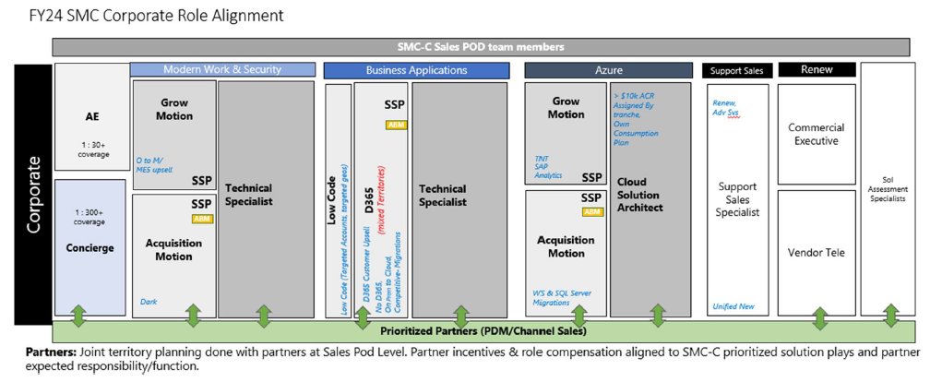
Managed Account Team Overview (SMC)
Microsoft account teams have a set account list that they receive at the start of the fiscal year (July). Their territory size ranges depending on the segment they support.
Note: The light blue highlights what each Specialist cares about, so be sure to stay targeted to that in your conversations with Microsoft.
AE: Account Executive
SSP: Solution Sales Professional
Technical Specialist can be shortened to TSP
Cloud Solution Architect can be shortened to CSA
Sol Assessment Specialist: Solution Assessment Specialist (SAS)

Slide 7
Microsoft Solution Plays
Streamlined Go-to-Market motions that provide a tangible way for partners to deliver transformative solutions to customers with impact and consistency
Business Applications
Accelerate Revenue Generation Modernize Service Accelerate Innovation with Low Code Optimize Finance & Supply Chain Scale Business Operations
Data, AI, & Innovation
Power Business Decisions with Cloud Scale Analytics Build & Modernize AI Apps Migrate Oracle Migrate Linux Accelerate Developer Productivity Accelerate Innovation with Integration Services
Azure
Migrate & Secure Windows Server & SQL Server Migrate SAP Innovate with HPC, AI Infrastructure Migrate Enterprise Apps
Modern Work
Secure Productivity Cloud Endpoints Converged Communications Frontline Worker Employee Experience Modernize with Surface
Security
Threat Protection with XDR & SIEM Data Security Modern SecOps

Slide 8
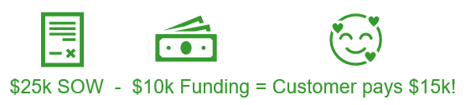
What is Microsoft Funding?
Microsoft may provide funding for Partners to engage with Customers on services that will drive consumption or adoption/usage of Azure, Business Apps, M365 Modern workplace or M365 Security.
In almost all cases, Microsoft funding needs to be tied to driving net new:
Licensing revenue
OR
Usage/consumption
Money goes 100% back to customer project to reduce cost of Long View delivered services.
Example:

